Slide 1
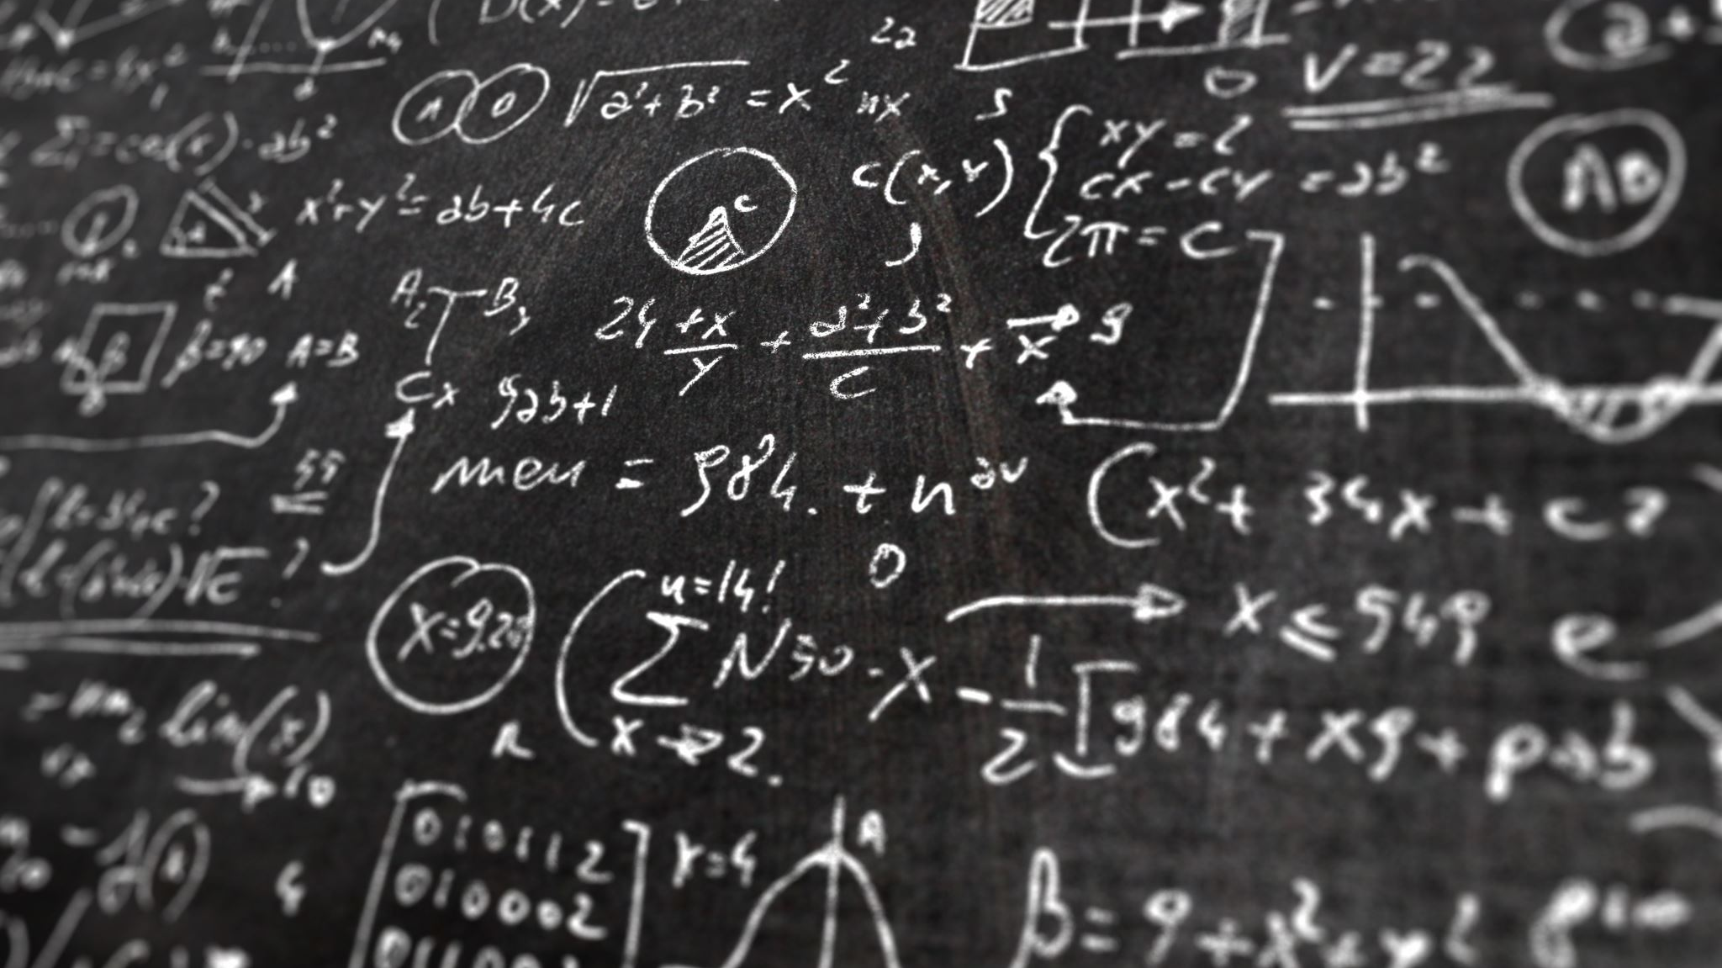
Module 1: Introduction To Algorithms
Group 1 Assignment:
Python code to implement the Average Calculator Algorithm.

Slide 2
Group Members
Felix Rono | Edna Mwenda
Julius Munah | Irine owando otieno
Ruth Angwa | Mark Ogutu
Awuor Gift Maggy | Mwamba Mati
Hellen Mati Moses | Sheillah J Kamarei
Ronald Kimutai | Gideon Kosgei
James Odipo | RONALD TANUI
Victor Keya | Tekviah Munandi
Ivy | Joseph Oyugi
Duncan Leteri | Stephen Waweru Kahuthu
Caleb Tonya | Felix Okal
Abigael Kanyasi Lew | Lawrence Mugambi
Ezekiel Bungei | Raphael Oyoo
Timothy muimi musya | Samwel kipsang
Vincent Otieno

Slide 3

Introduction
Design and implementation of average calculator algorithm
Objective:
In this graded lab activity, you are expected to create a flowchart, write pseudocode, and implement the algorithm in Python. This activity aims to assess your ability to develop basic algorithms and translate them into code.
Task: Implementing the Average Calculator Algorithm
The Average Calculator Algorithm is a basic algorithm that calculates the average of a set of numbers. It involves summing the numbers and then dividing by the count of the numbers.

Slide 4
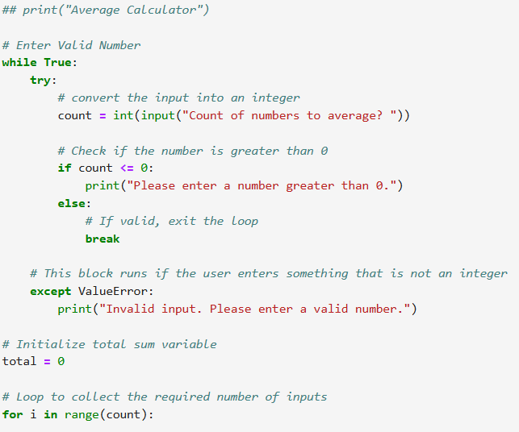
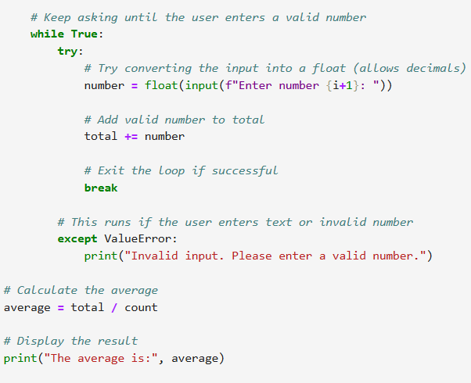
Python Code on Jupyter Notebook

Slide 5
Conclusion
The Average Calculator code demonstrates the effective use of loops, error handling to build a reliable and user-friendly application.
By incorporating( “TRY” and “EXCEPT”)blocks, the program prevents crashes caused by invalid inputs and ensures that users enter valid numerical values before proceeding.
The use of input validation and repetition structures (“while” and “for” loops) guarantees accuracy in calculating the total sum and computing the average.
This implementation highlights the importance of writing robust code that not only performs calculations correctly but also handles real-world user behavior gracefully.

